Slide 1
Motion Detection Using Digital Image Processing
By Frame Difference Method For developing Animal Repellent System in Agricultural Applications
K V B VEERRAJU (N170618
Y V SIVA REDDY (N171055)
K S S VAMSI (N171240)
V MOHITH (N170053)

Slide 2
WHAT IS MOTION DETECTION
INTRODUCTION

Slide 3
What is Motion Detection?
Motion detection is one of the intelligent systems which detect and track moving events .
Motion detection is a process of confirming a change in position of an object relative to its surroundings or the change in the surroundings relative to an object.
When detecting a motion ,the reference frame will be compared with other frames to find the differences in the pixel values, this differences in value will determine the object’s motion.
The main task of a motion detection system is to detect an motion present in an “area of environment being monitored.

Slide 4
Applications of Motion Detection
Intruder Alarms
Automatic Ticket Gates
Security Lighting
Automated sinks/toilet flusher
Hand dryers
Automatic doors
Entry way lighting

Slide 5
WHAT IS IMAGE PROCESSING

Slide 6
What is Digital Image Processing?
Image processing is the process of transforming an image into a digital form and performing certain operations to get some useful information from it. The image processing system usually treats all images as 2D signals when applying certain predetermined signal processing methods.
There are five main types of image processing:
Visualization - Find objects that are not visible in the image
Recognition - Distinguish or detect objects in the image
Sharpening and restoration - Create an enhanced image from the original image
Pattern recognition - Measure the various patterns around the objects in the image
Retrieval - Browse and search images from a large database of digital images that are similar to the original image.

Slide 7
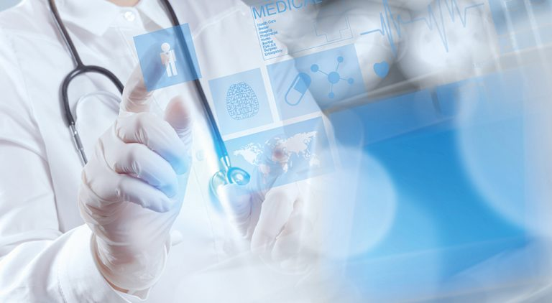
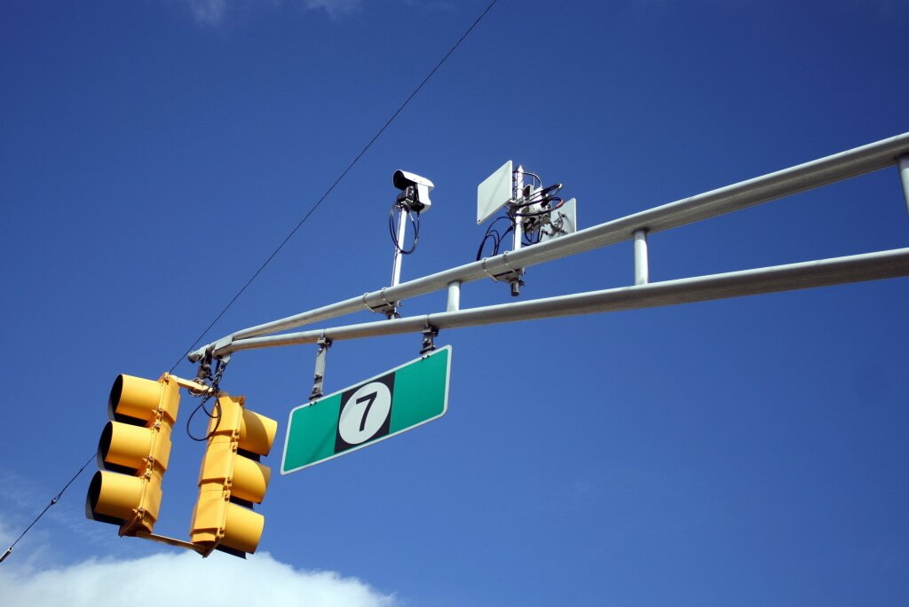
Applications of Image Processing ?
Medical Image Retrieval
Traffic Sensing Technologies
Image Reconstruction
Face Detection
Robot Vision
Self Driving Cars

Slide 8
WHAT IS CV MODULE?

Slide 9
What is CV Module?
OpenCV is an open-source library for the computer vision. It provides the facility to the machine to recognize the faces or objects.
OpenCV is used for computer vision in Artificial intelligence, Machine Learning, face recognition, motion detection, etc.
The OpenCV is defined as a field of study that helps computers to understand the content of the digital images such as photographs and videos.
Computer vision allows the computer to perform the same kind of tasks as humans with the same efficiency.

Slide 10
Functions Used in CV module
cv2.cvtColor() :- This function is used to convert image from one color space to another color space .
cv2.COLOR_BGR2GRAY() :- This function convert our original image from the
BGR color space to GRAY.
cv2.GaussianBlur() :- This function is used for reducing noise and blurring regions of an image .
cv2.absdiff() :- This function helps in finding the absolute difference between the first frame and other frame.
cv2.threshold() :- This function provides a threshold value, such that it will convert the reference frame <30(black frame) or >30(White frame).

Slide 11
Applications Of OpenCV
Biometric Systems :
Commonly deployed methods in the biometric description such as fingerprint , iris and face matching.
Automobiles:
Companies like Tesla and Waymo invested in self-driving cars, that will be assumed to be the future of the automobile industry.
Face Recognition:
Using machine learning and computer vision, it’s now possible to recognize the faces of a particular person either from videos or photos. In particular, this application can also be utilized in surveillance.

Slide 12
WHAT IS ANIMAL REPELLENT SYSTEM ?

Slide 13
What is Animal Repellent System ?
Animal Repellent System is used to repels the animals away from the agricultural fields or tribal villages , without harming the animals.
It ensures protection of humans as well as crops in the fields.
It also aware humans from wild animals while entering into the villages.

Slide 14
Case Study About Animal Repellent System
Wild animals claim 64 human lives so far this year in Kerala .
In Kerala Elephants attacked agricultural lands and also claimed most lives.
11 people have been killed in Tiger attacks in Uttarakhand this year so far.
In Sikkim 76,000 Hectares of organic farming land produces about
80,000 tonnes of vegetables every year but there are so many wild
animals that enter these farms and destroy 100’s of acres of organic
farming land.

Slide 15
FRAME DIFFERENCE METHOD

Slide 16
Frame Difference Method
Frame Difference Method is one of the finest method used in object motion detection.
Detection of moving object from a sequence of frames captured from a static camera is widely performd by Frame Difference Method the objective of the approach is to detect the moving object from the difference between the existing frame and the reference frame. The Frame Difrence Method is the common method of motion detection. This method adopts pixel-based difference to find the moving object.

Slide 17
Working Principle :-
Videos can be treated as stack of pictures called frames. Here we are comparing different frames (pictures) to the first frame which should be static (no movement initially). We compare two images by comparing the intensity value of each pixels.
These are the tasks involved in this project:
Capturing the first frame of the video.
Comparing each frame with the first frame.
Detecting the motion (if any).
Storing the time of motion of the object.

Slide 18
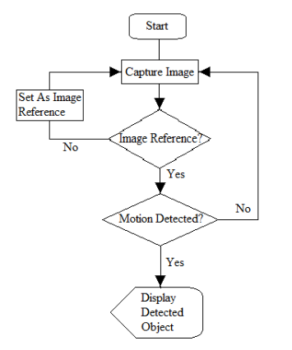
Flow Chart of Frame Difference Method

Slide 19
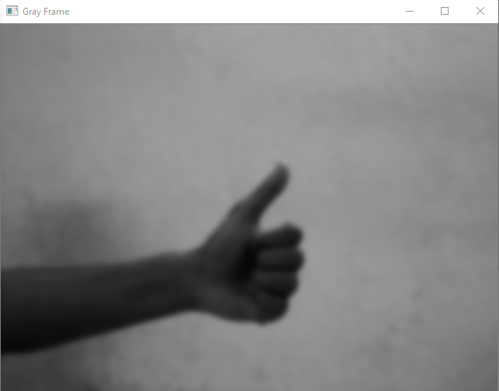
Output
Gray Frame:
In Gray Frame the image is a bit blur and in grayscale we did so because, In gray pictures thre is only one intensity value whereas in RGB (Red, Green, Blue) image there are three intensity values. So it would be easy to calculate the intensity difference in grayscale.

Slide 20
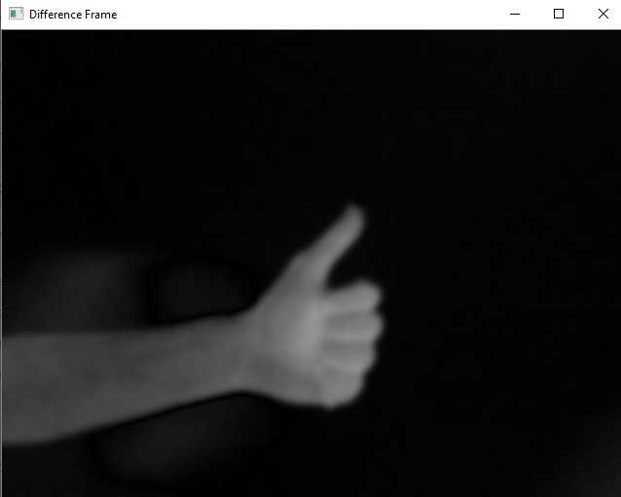
Output
Difference Frame:
Difference Frame shows the Difference of intensities of first first frame to the current frame.

Slide 21
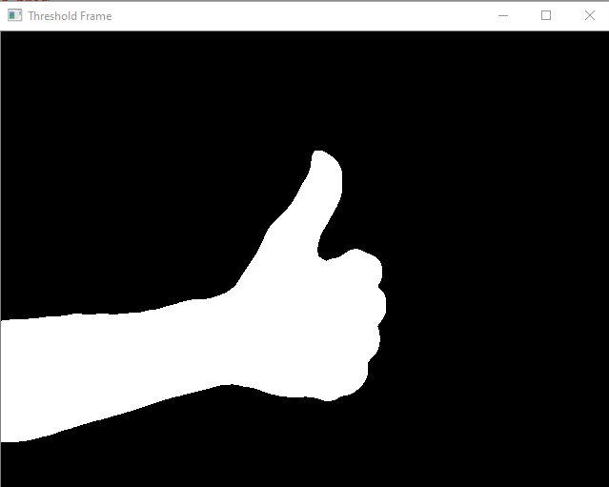
Output
Threshold Frame:
If the intensity difference for a particular pixel is more than 30 then that pixel will be white and if the difference is less than 30 that pixel will be black.

Slide 22
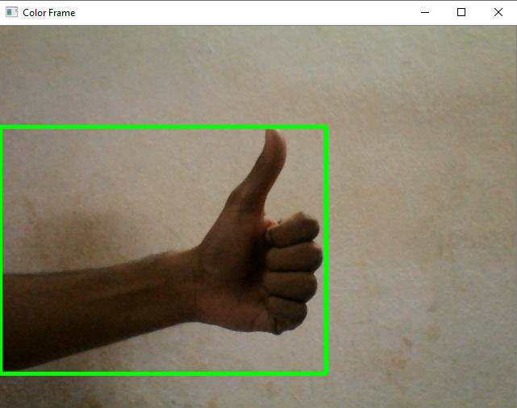
Output
Color Frame:
In this frame you can see the color frame along with green contour around the moving objects.

Slide 23
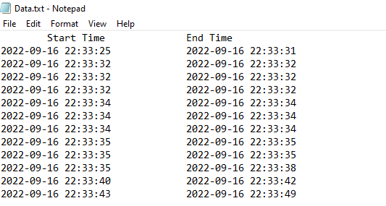
Output
Entry And Exit Time Data:
After execution, the entry and exit time of the moving object will be recorded in a txt file.

Slide 24
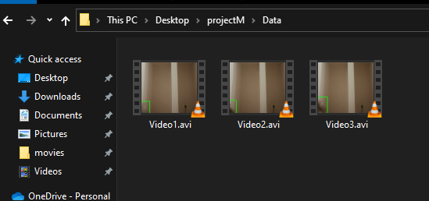
Output
Entry And Exit Video Data:
Motion detectors activate recording when movement is identified. This eliminates hours of unusable, non-applicable video consuming large amounts of memory and storage. It also improves battery life and conserves energy. This occurs whether you’re home, or awaythe entry and exit time of the moving

Slide 25
ADVANTAGES AND DISADVANTAGES OF THIS PROJECT

Slide 26
Advantages Of this project :-
A component of security cameras, motion detectors activate recording when movement is identified. This eliminates hours of unusable, non-applicable video consuming large amount of memory and storage. It also improves battery life and conserves energy. This occurs whether you’re home or away.
Motion detection also recognizes security camera-scene activities through analysis differentiation called pixel matching or frame referencing. This detects images that don’t match previously programmed camera settings including possible intruders.
The object or intruder entered into the frame will be captured using the camera and also stores the entry and exit data.

Slide 27
Limitations Of this project :-
By using this project, we can’t detect the far away moving objects.
It doesn’t perform well in low light area or atmosphere.
If the reference frame is disturbed, we can’t detect moving objects or intruders.
The proposed method also detects the motion due to the movement in air. As the air moves, the camera not remains in the position of static so when there is no movement of object then also it results motion and shows holes in the binary output image.

Slide 28
FUTURE SCOPE
At now this project is implemented for detecting objects and capture those images of the objects and also vary the entry time of the object and end time of the object.
In future this project will be implemented to detect the objects which are captured by surveillance camera and also implement for identifying the objects captured in system.
We had seen many cases about animals enter farmers fields and destroy crops. It has become a common problem for them and the growers have been left troubled and worried.
The movement stray animals enter their fields, farmers run after them and chase them out. To overcome from this problem we are detecting the animals by using motion detection and we record the video data of entry and exit time of the animal.
In future we want to develop a system that detects animals and chase them out from the farmers fields.
In future we want to develop Animal Repellent System using Motion Detection in Digital Image Processing for Agricultural Applications.

Slide 29
CONCLUSION
In the present research, moving object is detected by the method of motion detection, which composes of frame difference method and morphological operations.
The obvious keystone of the work is studying the principle of frame difference method and to resolve the various problems.
The experiment shows that the method has good performances and efficiency.
Future enhancement may include alerting the user by sending multimedia SMS, by email or by capturing video and streaming it online.
In future we are planning to implement this project into Animal Repellent System In Agricultural Applications. To prevent animals entering into the agricultural fields and causing damage.

